Slide 1
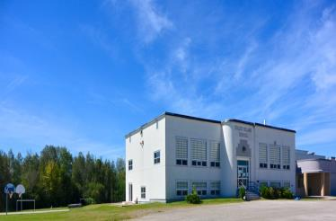
Sustainability Study of Coles Island School
Revised: November 17, 2014

Slide 2
Public Meeting #1 Agenda
Introductions
Review of Provincial Policy 409 Multi–Year School Infrastructure Planning
Presentation of Facts – Coles Island School
Question and Answer
What’s Next?
Online Resources and Feedback
Next Meetings
Notes:
Explain what “sustainability” means.
Maintain the status-quo at Coles Island School
Invest dollars into the infrastructure/programming at Coles Island School
Close Coles Island School and move the students to another school for their continued education

Slide 3
Provincial Policy 409: Multi-year School Infrastructure Planning
Outlines a number of responsibilities to do with facilities in our system
Sections 6.4, 6.5 and 6.6 are relevant for Sustainability Studies
Three Public Meetings
#1 – Presentation of Facts from District regarding School, in line with Policy 409 template
#2 - Presentation from Stakeholders regarding their thoughts on the sustainability of the school and relevant factors
#3 – Final Review of Information by DEC and subsequent motion on next steps
Not Designed as an “Us-Against-Them” process; public meetings are not designed to facilitate debate between two parties

Slide 4
Enrolment

Slide 5
Enrolment

Slide 6
Projected Enrolment

Slide 7
Enrolment by Grade Level

Slide 8
Functional Capacity
Student Enrolment | Number of Classrooms | Classrooms in Use | School Capacity | Capacity Rating
30 | 6 | 3 | 144 | 20.8%

Slide 9
Health and Safety Building Assessment

Slide 10
Building Summary
Constructed in 1957 with a wood frame structure, a wood roof and interior wood walls . Heated by electric heaters in the original part of the school and a ventilation system in the new addition.
Renovations have included:
1992 –Gymnasium addition
The addition and removal of 2 modular classrooms

Slide 11
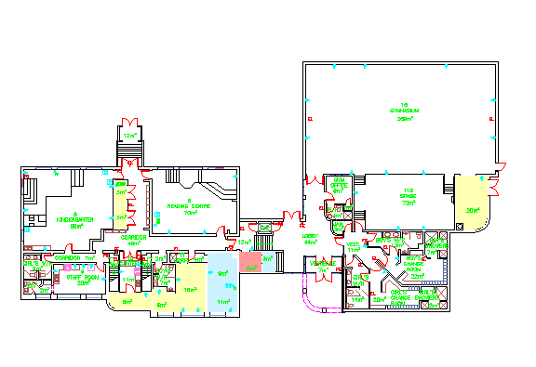

Slide 12
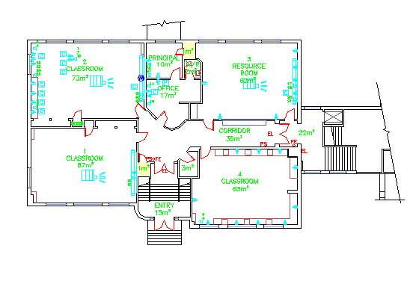

Slide 13
Classrooms
The school was constructed with 6 classrooms.
Presently:
3 classrooms are being used for classroom teaching spaces
1 classroom is being used as a resource area
1 classroom is being used as a reading center
1 classroom is used by a community playgroup

Slide 14
Stairwells and Corridors
One phase of stairwell upgrades have been completed at the school.
The main entrance stairwell remains to have an upgrade and is on the Capital Improvement Projects list.

Slide 15
Fire Protection
A fire alarm system is installed that is monitored by National Alarm.
The building does not have a sprinkler system.
Fire extinguishers are located throughout the building.
Fire alarm pull stations are located at the exits and throughout the school.

Slide 16
Domestic & Waste Water
Water from a private well passes through a Sterilight ultraviolet water sterilizer, filter and water softener before entering the distribution system.
Hot water is heated with a Giant Cascade 50 gallon electric hot water heater.
There is a sewage treatment system located at this school.

Slide 17
Heating & Ventilation
Electric heat throughout the original section of the school.
The new section of the school (with the gym) has a ventilation system.
Relies on operable windows to bring fresh air into the original portion of the school and exhausts through gravity vents found in the classrooms.

Slide 18
Controls & Communications
Recently the controls system was replaced with new Enteliweb system from Delta. The controls are accessible remotely through the internet.

Slide 19
Electrical & Lighting
There is a transformer that feeds power underground into the school.
Fluorescent, 4 foot T12 lights in the classrooms and Hallways.

Slide 20
Exterior
The siding is stucco finish.
The windows are glass block with sliders on the bottom.
2 bottom floor classrooms have 6 foot sliding patio doors.

Slide 21
Property
There is an entrance and an exit onto the Route 10 Highway.
Staff and visitors share the school parking lot .
The driveway is shared by the bus loading zone and parent drop off.
There are 2 swing sets, a play structure, a ball diamond and a soccer field. There is also a small basketball court.

Slide 22
Capital Investments and Improvement Projects
Year | Scope of Work | Cost
1992 | Gym Addition | Unknown
1996 | Modular Classrooms | Unknown
2001 | Playground Upgrade | 2,000
2003 | Water Softener Installation | 2,200
2004 | Flag Pole upgrade | 8,478
2005 | Fire Integrity | 4,525
2006 | Custodial Room upgrade | 6,641
2008 | Exterior Cleaning and Repair | 5,000
2011 | Modular Classroom Removal | 642

Slide 23
School Physical Plant Status
Project Category |  | Description | Estimated Cost
Fire Integrity | Fire Codes | Stairwell enclosure at main entrance.
Mechanical and Electrical | Heating and Ventilation | Ventilation system in the main portion of the school.
Site | Site Improvement | Curbing and driveway refinishing.
 |  |  | $289,000

Slide 24
Education Programs and Services

Slide 25
Education Programs and Services
Provincial staffing formula calls for:
3.3 FTE for classroom teachers
0.4 FTE for administration
0.1 FTE for guidance
0.2 FTE for resource
Total is 4.0 FTE teaching staff, including principal of the school
Grade 5 Students from Coles Island feed into Chipman Forest Avenue School

Slide 26
Coles Island School Student : Teacher Ratio
 | Total Number Student : Teacher | Student : Teacher
2014-2015 | 30 : 4 | 7.5 : 1
2013-2014 | 28 : 4 | 7.0 : 1
2012-2013 | 37 : 4 | 9.25 : 1
2011-2012 | 30 : 4 | 7.5 : 1

Slide 27
K – 5 Comparable Student : Teacher Ratio
 | Total Number Student : Teacher | Student : Teacher
Chipman Elementary | 104 : 8 | 13.0 : 1
Lincoln Elementary | 171 : 13.5 | 12.7 : 1
Geary Elementary (extenuating circumstances this year) | 161 : 13.5 | 11.9 : 1

Slide 28
Maximum class sizes
Grade Level | Maximum Students
Grade K – 2 | 21
Grade 3 | 26
Grade 4 – 5 | 28
Combined K-3 | 16
Combined 3 – 5 | 23

Slide 29
Coles Island School Actual Class Sizes 2014-2015
Grade Level | Students
K/1 | 11 K = 4, Grade 1 = 7
2/3 | 7 Grade 2 = 4, Grade 3 = 3
4/5 | 12 Grade 4 = 5, Grade 5 = 7

Slide 30
Comparable Class Sizes 2014-2015
Chipman Elementary
K | 14
1 | 14
2 | 21
3 | 17
4 | 20
5 | 18

Slide 31
Comparable Class Sizes 2014-2015
Lincoln Community School
K | 15
K | 15
1 | 18
1 | 19
2 | 13
2 | 13
3 | 20
3/4 | 19 Grade 3 = 8; Grade 4 = 11
4 | 21
5 | 18

Slide 32
Comparable Class Sizes 2014-2015
Geary Community School
K | 15
K | 13
1 | 17
1 | 19
2 | 16
2 | 17
3 | 20
4 | 16
5 | 28

Slide 33
Other Staff
1.0 Educational Assistant
Administrative Assistant: 36.25 hours a week
Library Assistant: 5 hours a week
Cleaning staff: 40 hours a week

Slide 34
Delivery of Programs
Physical Education offered daily to each individual grade level by the principal
EST – Literacy support as part of a cluster of 5 schools
EST – Numeracy support is provided upon request
School Intervention Worker (SIW) support is available as part of a cluster of 4 schools
EST – Resource is onsite 0.2 designation
EST – Guidance is onsite 0.1 designation

Slide 35
Special Events and Initiatives
Christmas Concert
Science Fair
Reading Challenges
Enrichment clusters
Red Cross swimming lessons
Terry Fox Walk
Family picnics
Hot lunch twice a week
Cultural events: TNB productions, Playhouse, Kings Landing , Saint Martins
Jump Rope for Heart
Canteen days
Coles Island School scholarships for students pursuing further education
Waste Reduction Week
School – wide brunch

Slide 36
Provincial Assessment Data

Slide 37
Provincial Assessment Results
Grade 2 Reading
Year | Coles Island | District | Province
2009-10 | 66.7% | 87.4% | 83.6%
2010-11 | 100.0% | 83.5% | 80.3%
2011-12 | 57.2% | 78.0% | 79.1%
2012-13 | 50.0% | 80.3% | 79.5%
2013-14 | Class Size too small to allow us to report | 76.8% | 77.5%

Slide 38
Provincial Assessment Results
Grade 4 Reading
Year | Coles Island | District | Province
2009-10 | 90.0% | 89.0% | 83.4%
2010-11 | 75.0% | 86.8% | 80.5%
2011-12 | 70.0% | 77.5% | 77.1%
Results not available after 2011-12 due to changes in the Provincial Assessment system.

Slide 39
Provincial Assessment Results
Grade 5 Numeracy
Year | Coles Island | District | Province
2009-10 | 50.0% | 65.5% | 59.4%
2010-11 | 40.0% | 64.3% | 60.8%
2011-12 | 66.7% | 69.9% | 63.7%
2012-13 | 50.0% | 64.0% | 62.9%
2013-14 | NA | 60.0% * | 59.4% *
* Based on a 20% sample of students.

Slide 40
Student Perception Data
Based on the 2013-14 Student Perception Survey Results;
100% of students value school outcomes and see the importance of it to their future.
86% of students have both a positive sense of belonging and feel safe at their school.
71% of students have positive relationships with peers within the school.
43% of students reported that they were interested and motivated in their learning.

Slide 41
School Benefits
Strong knowledge of individual students, as well as their strengths and needs.
Small class settings create the opportunities for staff to provide one on one attention more readily.
Culture of collaboration is established among staff.

Slide 42
School Challenges
Staff in positions of responsibility are often required to teach specialty subjects and have a large percentage of time dedicated to teaching.
Grade 4 students are part of a Grade 4/5 combined class, therefore scheduling needs to take this into consideration to meet the requirement of the Intensive French Program and Grade 4 curriculum.
Lack of ability to consistently provide instruction by subject experts in music and PE.

Slide 43
Transportation
Coles Island School
11390 Route 10
Coles Island, NB

Slide 44
Transportation
It is important to note that currently students in grades 6-12 that reside in the Coles Island Catchment area are bussed to Chipman Forest Avenue School for secondary studies.
The morning school bus system currently sees three busses transport all students within the Coles Island catchment area into the Coles Island School, where the Grade 6-12 students transfer onto one bus and proceed to Chipman Forest Avenue School.

Slide 45
Transportation
The afternoon school bus system currently sees two busses transport the K-5 Coles Island students home.
These two buses then meet the transfer bus with the 6-12 students from Chipman Forest Avenue School to deliver the students home in a timelier manner.
By not sending all students (K-12) residing in the Coles Island catchment area to the same school, it is likely there would need to be an additional two school buses and drivers added to our transportation system.

Slide 46
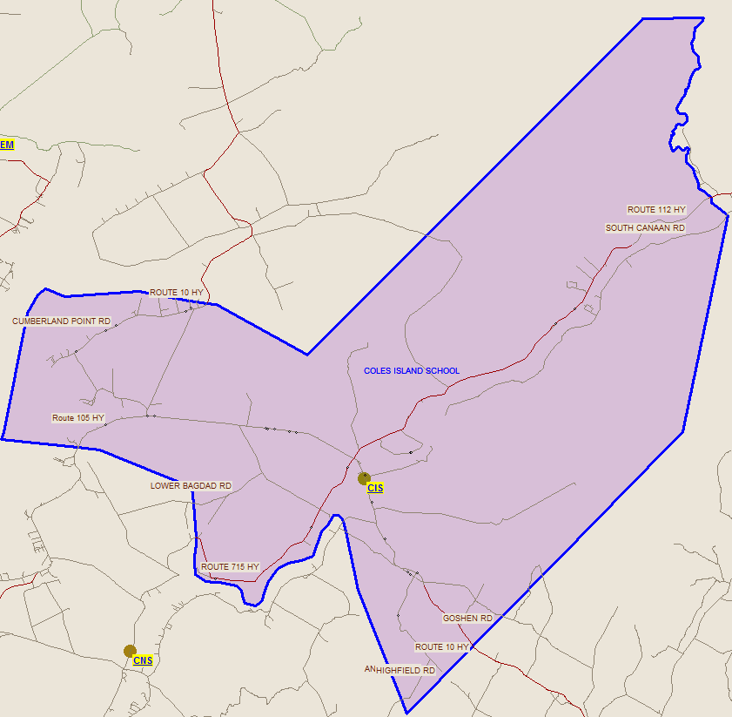
Current Bus Route

Slide 47
Current Student Address Distances
Student | Distance to CIS (km) | Distance to CES (km) | Distance to CNS (km) | Distance to Sussex (km) | Distance to Havelock (km) | Shortest of Four Proposed(km)
1 | 6 | 49.5 | 22.7 | 27.5 | 50 | 22.7
2 | 4.9 | 38.7 | 24.3 | 38.3 | 60.3 | 24.3
3 | 6.6 | 44.3 | 16.7 | 40 | 62.6 | 16.7
4 | 19.3 | 25.1 | 26.1 | 52.7 | 75.3 | 25.1
5 | 21.1 | 29 | 27.9 | 54.5 | 77.1 | 27.9
6 | 3.2 | 43.7 | 20.1 | 36.6 | 59.2 | 20.1
7 | 12.6 | 30.9 | 19.5 | 46 | 68.6 | 19.5
8 | 10.4 | 53.9 | 26 | 31.5 | 54 | 26
9 | 18.5 | 31.6 | 25.3 | 52 | 74.5 | 25.3
10 | 12 | 49.3 | 11.3 | 45.4 | 68 | 11.3
11 | 6 | 49.5 | 22.7 | 27.5 | 50 | 22.7
12 | 21.1 | 29 | 27.9 | 54.5 | 77.1 | 27.9
13 | 10.2 | 53.7 | 26.2 | 31.2 | 53.8 | 26.2
14 | 4 | 42.8 | 19.2 | 37.5 | 60 | 19.2
15 | 12.2 | 31.3 | 19.8 | 45.7 | 68.3 | 19.8
16 | 6.8 | 44.5 | 16.5 | 40.3 | 62.8 | 16.5
17 | 5.2 | 41.6 | 25.9 | 38.7 | 61.2 | 25.9
18 | 20.5 | 29.6 | 27.3 | 54 | 76.5 | 27.3
19 | 12 | 49.3 | 11.3 | 45.4 | 68 | 11.3
20 | 1.4 | 44.9 | 21.5 | 32.1 | 54.7 | 21.5
21 | 5.2 | 41.6 | 25.9 | 38.7 | 61.2 | 25.9
22 | 6.5 | 44.2 | 16.7 | 39.9 | 62.5 | 16.7
23 | 6 | 49.5 | 22.7 | 27.5 | 50 | 22.7
24 | 6.3 | 37.2 | 22.8 | 39.7 | 62.3 | 22.8
25 | 6.2 | 37.3 | 22.9 | 39.6 | 62.2 | 22.9
26 | 12 | 49.3 | 11.3 | 45.4 | 68 | 11.3
27 | 1.9 | 42.8 | 21.4 | 35.3 | 57.9 | 21.4
28 | 14.8 | 42.6 | 35.5 | 48.2 | 70.8 | 35.5
29 | 4 | 42.8 | 19.2 | 37.5 | 60 | 19.2
30 | 4.9 | 48.4 | 21.9 | 28.6 | 51.2 | 21.9
Minimum Distance | 1.4 |  |  |  | Minimum Distance | 11.3
Maximum Distance | 21.1 |  |  |  | Maximum Distance | 35.5
Average Distance | 9.4 |  |  |  | Average Distance | 21.9

Slide 48
Approximate Bus Riding Times
School | Distance 1-way from CIS | Longest Ride In | Longest Ride Out | Earliest Pick-Up | Latest Drop-Off
Sussex Elementary School | 40km | 1h 19min | 1h 19min | 6:51 | 3:44
Cambridge Narrows School | 23km | 1h 5min | 1h 5min | 7:10 | 4:05
Chipman Elementary School | 43km | 1h 21min | 1h 21min | 6:59 | 4:21
Havelock Elementary School | 60km | 1h 36 min | 1h 36 min | 6:39 | 4:36
Coles Island School | - | 45min | 45min | 7:00 AM | 3:20 PM

Slide 49
Finances

Slide 50
Salaries
 | Actual Costs
Cost Centers | Fiscal Year | Fiscal Year | Fiscal Year
 | 2013-2014 | 2012-2013 | 2011-2012
Salaries
Administration | 17,309 | 12,742 | 12,740
Teacher | 317,946 | 282,756 | 277,412
Admin.Assist/Library Assist | 28,307 | 27,258 | 26,604
Teacher Assistant | 27,066 | 40,845 | 39,153
Custodian | 34,765 | 34,436 | 33,754
Total | 425,393 | 398,037 | 389,664

Slide 51
Assigned Budgets
 | Actual Costs
Cost Centers | Fiscal Year | Fiscal Year | Fiscal Year
 | 2013-2014 | 2012-2013 | 2011-2012
Assigned Budgets
Regular Instruction | 6,782 | 8,492 | 6,730
Admin.Support | 1,673 | 1,612 | 1,351
Library | - | - | -
Teachers Working Conditions | 1,610 | 1,571 | 1,561
Nutrition | 345 | 1,104 | 1,104
Bilingual Learning Environment | 250 | 250 | 275
Wellness Grant | 435 | 433 | 442
Positive Learning | - | - | 2,002
Co/Extra Trips | 352 | 339 | 1,018
PSSC | 110 | 254 | 368
Total | 11,558 | 14,055 | 14,850

Slide 52
Facilities Costs
 | Actual Costs
Cost Centers | Fiscal Year | Fiscal Year | Fiscal Year
 | 2013-2014 | 2012-2013 | 2011-2012
Facilities Costs
Electricity | 30,138 | 27,904 | 26,654
Garbage Removal | 1,912 | 2,289 | 1,757
Ground Maintenance | 5,952 | 8210 | 8147
Cleaning Supplies | 359 | 1,561 | 1,257
Minor Repairs | 12,473 | 11,629 | 11,404
Total | 50,833 | 51,593 | 49,219

Slide 53
Total Costs
 | Actual Costs
Cost Centers | Fiscal Year | Fiscal Year | Fiscal Year
 | 2013-2014 | 2012-2013 | 2011-2012
TOTAL COSTS | 487,784 | 464,045 | 453,733

Slide 54
Impact on the Community
Parent participation in school activities would require travel to Cambridge Narrows Community School, Chipman Elementary School or Sussex Community School if Coles Island were to close
Community members generally travel to Sussex for shopping
The only community group using the building on a regular basis (2 x week) is Care-N-Share out of Chipman. This is a Mom & Tot program
There is no evidence the community will grow in the near future
Coles Island is a Local Service District that does not have an active committee

Slide 55
Impact on Other Schools
There are a few of options for students should a closure of Coles Island School result. These options would include Cambridge-Narrows Community School, Chipman Elementary School or Sussex Community School.
Notwithstanding the options presented, there is capacity at every option school for the students at Coles Island.

Slide 56
Option 1:
All students in the Coles Island catchment attend the Chipman Schools.
Impact:
Assuming the current trends for enrolment of K students, Chipman Elementary School would see the influx of 27 Coles students. That combined with the current population of 100 CES students, would produce a total population of 127 students.
There would be little change in the number of classes needed to cover this influx because 27 students are spread over 6 grades. There is one trouble spot in that Grade Two could be potentially over by one student causing either a split class be set or an additional 1 FTE added to staff.
The funding formula for CES would change little in regards to Administration, Guidance and Resource FTE. We top up those areas as it is already. Funding formula would say …6.6 approved classes, .5 Admin, .7 Resource, .2 Guidance for a total FTE of 8.0. The Superintendent would have to approve adding 1 FTE with the addition of over 20 students.
Chipman Forest Avenue would not see any impact as they are receiving Coles students now. Because of the number of students graduating and those coming in, the population of CFAS would decrease by 2 students overall. No impact on staffing or capacity.

Slide 57
Option 2:
All students in the Coles Island catchment (K-12) attend Cambridge Narrows School.
Impact: Substantial.
Cambridge would essentially go from a projected school population of 140 to 213, an increase of 73 students. An increase of more than half their regular projected population to date. There is capacity for this increase because the population added is distributed over 13 grades. If you combined some classes at elementary and some at middle level, leaving grade 5 alone, the school can get by with five classes at K to 5, two classes at 6 to 8 and 4 classes at 9 to 12. Many of these split classes would be at capacity and thus leaving little room for extra students. So staffing-wise, there would be 14 classrooms, .8 Admin, .4 Guidance and 1.2 Resource for a total of 16.4. This is up from the current FTE of 14.2. This does not include a topping up of admin or Guidance that is traditionally done. It should be noted we are not currently studying the catchment for Grade 6-12 students who live in the Coles Island area.
Result. An increase of 2.2 FTE. Some of the Coles FTE could go there should their skill set fit in with the CNCS plan.
The impact would be significant on the CFAS. CES hasn’t been getting Coles student so the impact on their capacity or staffing is minimal.
For CFAS, it would mean have greater impact because all of the Coles students would have left (considering there was no bussing grandfathering), a possible reduction of 42 students for the 2015/2016 school year. This is in addition to the school losing 9 students as 18 graduate and 9 come in from CES. A total of 51 student decrease with the greatest impact in grade 9.
With a projected population of 172 for next year, CFAS could lose approximately 47 students. At 125 students their FTE would be affected. They would lose two high school classes alone. Plus a reduction in Admin, Guidance and Resource FTE.

Slide 58
Option 3:
Split of the Coles Island catchment students at McCready’s. If the boundary was set at McCready’s Restaurant by the Trans Canada Highway. Students on the Sussex side go to CNCS and students on the Grand Lake side go to Chipman schools, the following would occur:
CES would receive 22 students
CFAS would receive 25 students
CNCS would receive 9 elementary and 8 high school students.
Impact:
No effect on capacity. A small increase in FTE is possible in the Chipman but the schools can manage at the current FTE rate. At CNCS, very little impact.

Slide 59
Option 4:
Students go to what school is geographically closest to them or personal child and family decisions.
Distribution of FTE from Coles Island
If the school were to close, staffing would be cared for under the terms of the various collective agreements.

Slide 60
Advantages to Changing Schools
Some of these other schools are actually closer to where the student lives. Less of a bus drive.
Both CFAS and CNCS have inter and intramural sports programs.
CES offers fewer combined classes at the current time.
CNCS allows all the students of every grade to be together, much like the CIS days of old, counteracting the loss of community.
CES has more FTE with expertise in the specialties areas (Guidance, Resource).
More after school activities at CES, CNCS.
More funding for technology.

Slide 61
Disadvantages
CIS has a nicer and more proper gym facility than CES.
Loss of attendance at school in home community.
Higher student to teacher ratio.
Staff know their families well. Maybe slightly more than the other option schools.
Possible longer bus rides to school and back thus, a longer day.

Slide 62
Teamwork
All schools have specialty teams in their settings. The difference is that Coles Island has only 4 full time staff members and thus their teaming is melded into one. The same folks are in their K-2, 3-5, ESS and Core Leadership teams. In the other schools, they would be exposed to a more diverse teaming experience.
All the other school options have specialty teams made up of different teachers.
CES has a K-2, 3-5, and ESS, and CNCS has a K-5, 6-8, 9-12 and ESS teams. Because they each have these separate grade teams, they have team leaders for each group and that group, along with the admin and some of the ESS folks make up their Core Leadership Teams.
This would be a bonus for the teachers of Coles Island. A one team decides everything scenario has the potential of going stale or cause great problems if it is not functioning properly.

Slide 63
Resources
Should Coles Island School close, the following resources would be shared in a manner that would continue to see Coles students benefiting:
Extra physical education equipment at the elementary level.
A couple of Smartboards (relatively new)
Projectors and document cameras
A Mac Cart
Three or more iMacs
A piano and maybe some music equipment for the elementary level
Literacy and Numeracy materials (books, manipulatives, the latest and newest, very expensive Math program, possible Science materials from the old Science lab)
Library furniture (elementary) that they put together as they renovated their library.
Possible good quality student desks and chairs.

Slide 64
Consultations
Economic Development
NB Dept. of Economic Development
Invest NB
Enterprise Central
Environment and Local Government
Community Inclusion Network New Brunswick
Business NB
Vail’s General Store (ESSO Service Station)
Connells Grocery (KWIK Way)
McCready’s Motel & Restaurant (Irving Service Station)
Care ‘N’ Share Inc.

Slide 65
Economic Development
Businesses or other organizations that have closed:
Harvest Restaurant
DNR office
Government Garage

Slide 66
Economic Development
Existing Businesses in the area:
Vail’s General Store
Connell’s Grocery
McCready’s Motel & Restaurant
Care ‘N’ Share Inc.
TNT Campground
Campers Cove Campground
Several small businesses employing 1-9 people, including H W Hawker Ltd., Stephen Snodrass Welding and Steelwork

Slide 67
Economic Development
Findings:
The twinning of the Trans-Canada Highway in 2001 contributed to business closures and an economic downturn for businesses in the Coles Island area.
Prior to 2001, the Coles Island shortcut was used by many drivers as a way to avoid slow moving truck traffic on the Trans-Canada.
With the twinning of the highway, much of the traffic disappeared as well as the resulting revenues.

Slide 68
Economic Development
Residents of the Coles Island area commute to the Sussex, Chipman, St. John and Moncton areas for work and shopping
There are no community groups or organizations that use the school on a regular basis, although it has been used on occasion by church youth groups, a political organization, and has been the site for a few birthday parties.
There are no recreational groups or organizations within the community.
The Care ‘N’ Share Inc. Family Resource Center operates out of the school on Monday and Thursday mornings from 10:00-12:00. (Awaiting opportunity to speak with the Care ‘N’ Share director.)

Slide 69
Economic Development
Within the last few years the local Department of Natural Resources office closed, and the Department of Transportation garage moved to Waterborough.
Although there is local talk of the possibility of a potash mine reopening in the Berwick area (approx. 35 minutes away), there is no economic development plan for the area, no indication of any businesses that might open in the area, and the mine was not mentioned by any of the contacts made with government.

Slide 70
Economic Development
Local store/service station owners and managers each spoke to the potentially negative impacts on their businesses in regards to reduced revenues and employment.
There was concern expressed as to the impact on the area’s population, should the school close; in particular, new families choosing to live elsewhere.
In a recent visit to the Coles Island area, no new housing starts were noted.

Slide 71
Provincial Policy 409
Determination made by Anglophone West School District Education Council to review the sustainability of Coles Island School under Policy 409 was made on October 23, 2014
Timeline was created to conduct the study in a fair, open and responsible manner
Policy 409 can be found online, at our Website or at www.gnb.ca (follow links below)
Choose Education and Early Childhood Development under Departments
Choose “Policies” from categories along the left hand side
Choose Policy 409

Slide 72
Questions and Answers

Slide 73
Coles Island Sustainability Study – Visit our Website for Details!
Sustainability Study Timeline
Minister Letters
Parent Letters
Coles Island at a Glance
Link to Policy 409
Public Meeting #1 – Presentation
Feedback can be given
via email at asdwsustainability@nbed.nb.ca
through our discussion board at the Coles Island Sustainability Study site on our webpage
mail to Carol Clark-Caterini, Anglophone West School District, 1135 Prospect Street, Fredericton, NB E3B-3B9
Notes:
Reminder of what “sustainability” means:
Maintain the status-quo at Coles Island School
Invest dollars into the infrastructure/programming at Coles Island School
Close Coles Island School and move the students to another school for their continued education

Slide 74
Thank you for coming!
Revised: November 17, 2014

